Slide 1
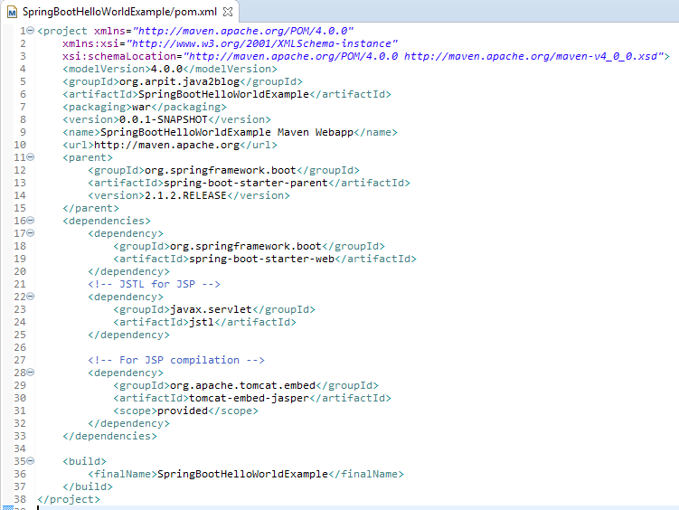
Spring Boot web application example
The spring-boot-starter-parent provides you all maven defaults required for any spring project.
Since we are developing a web application, we also need to add spring-boot-starter-web dependency. This will include additional dependencies such Spring boot, tomcat etc which are required for this application.

Slide 2
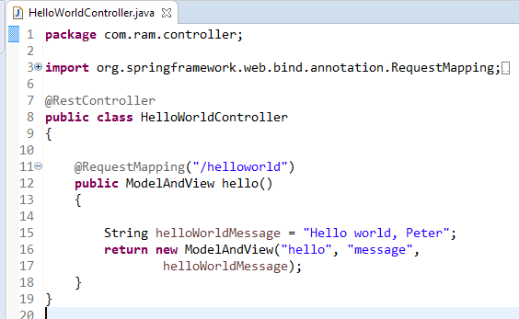
Spring Boot web application example
As request first goes to dispatcherServlet and it redirects to the controller class.
Here @Controller depicts that this is our controller class.
@RequestMapper is used to map incoming HTTP request to handler method(hello()).So hello() method of HelloWorldController.java will handle GET request from dispatcher
So when we have url of http://localhost:8080/helloworld - hello() method will be called

Slide 3
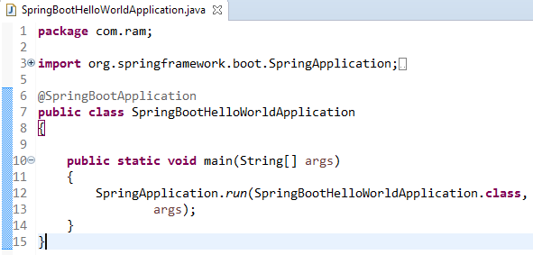
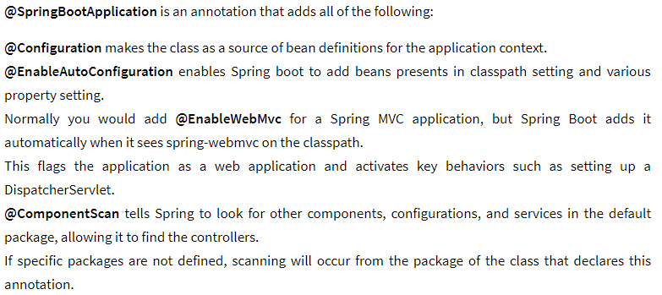
Spring Boot web application example

Slide 4

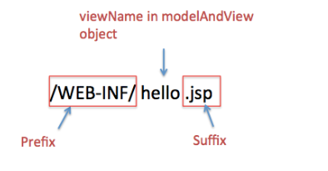
Spring Boot web application example

Slide 5
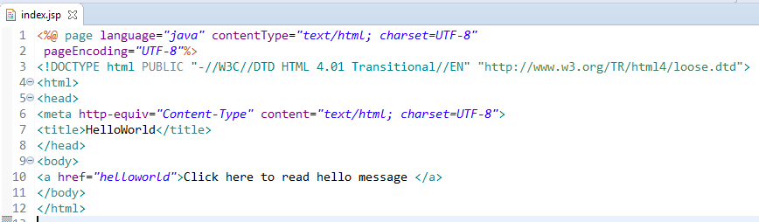
Spring Boot web application example

Slide 6
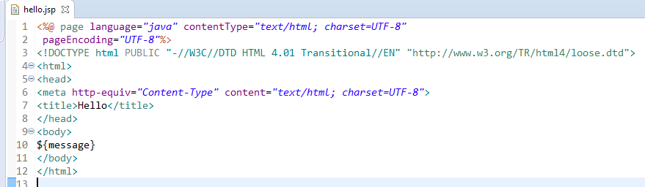
Spring Boot web application example
Create hello.jsp in /WEB-INF/ folder

